Slide 1

School of Electronics Engineering (SENSE)
Project-I (2026)
Task-Aware Object Identification for Assistive Robotics using PYNQ-Z2
Student Name(s):
Shubh Gupta — 23BLC1322
Aarav Sharma — 23BLC1300
Ankush Kumar Jaiswal — 23BLC1179
Guide's Signature with Date
Guide:
Prof. Jean Jenifer Nesam J, SENSE
Signature: _____________________
Programme / School:
B.Tech — SENSE, VIT Chennai
Date: _________________________
Review & Date:
Review-II · 30.09.2026 (Wednesday)
Approval is mandatory before every review. After signing, scan this slide and keep the scanned copy as Slide 1 of the presentation.
1

Slide 2
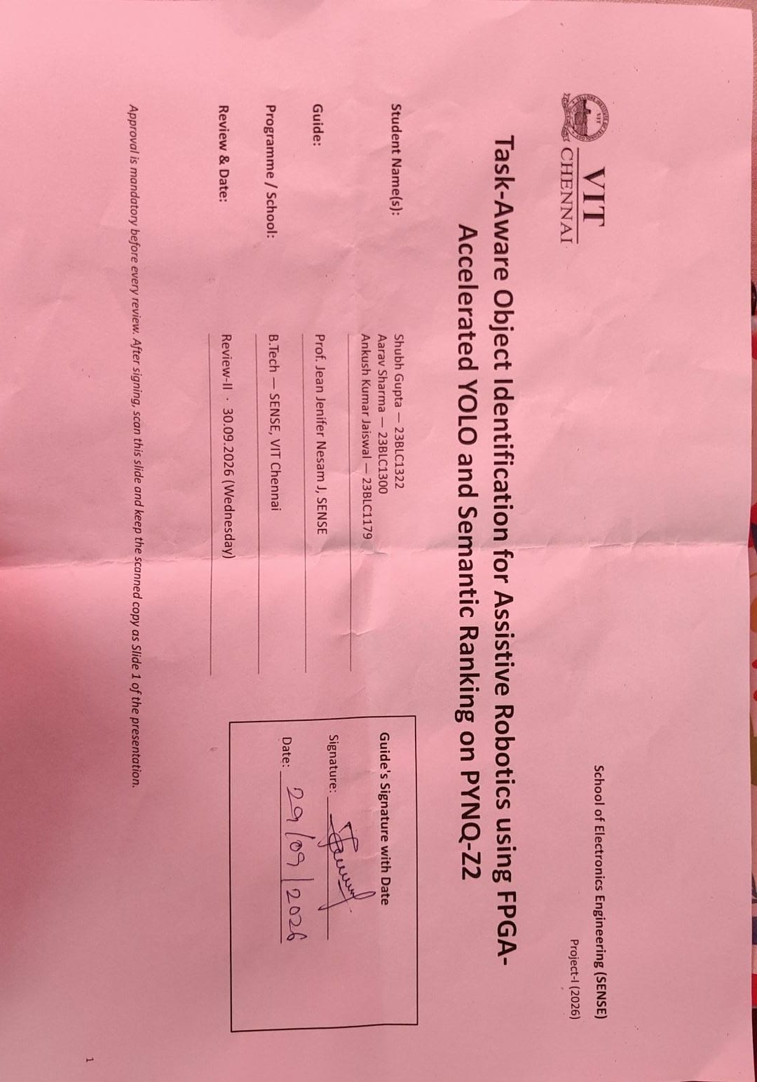

Slide 3
Introduction & Problem Recap
Problem recap: an object detector tells a robot what is in the scene, but not which object satisfies a spoken task. Asked “bring me something to sit on”, an assistive robot must choose the chair, not just list chair, TV and laptop.
Review-II focus: the general task-aware vision system from Review-I is now narrowed to one application: assistive robotics (a home / care-assist robot that finds the object a user asks for).
Objectives:
Run Tiny YOLOv2 detection on the PYNQ-Z2 (Zynq XC7Z020) as the robot’s on-board perception.
Rank the detected objects against a natural-language task using CLIP text embeddings and cosine similarity.
Output the selected object’s class, confidence, score and bounding box as a robot-ready target.
Keep inference on the edge board: ~30 FPS target within a < 15 W power envelope.
Refinements since Review-I:
Scope narrowed from six candidate applications to assistive robotics.
End-to-end pipeline (detect → filter → CLIP encode → rank → select) now runs on the PYNQ-Z2 board.
Output formalised as JSON + annotated frame for a robot controller; literature extended to 15 papers.
2

Slide 4
Application Focus: Assistive Robotics
How the system serves an assistive robot, from spoken request to action
1 User request
“Bring me something to sit on”
2 Camera
Frame of the room captured
3 FPGA detection
Tiny YOLOv2 on PYNQ-Z2 finds chair, TV, laptop, person
4 Semantic ranking
CLIP task embedding vs. object labels → scores
5 Action
Chair selected; bbox guides navigate / grasp
Why assistive robotics
Users give tasks, not class names
Elderly or mobility-impaired users say what they need (“something to drink from”), so the robot must map intent to an object.
Must run on the robot
Battery-powered robots need low-latency, low-power, private on-board inference; no cloud round-trip.
Matches our FPGA + CPU split
Heavy convolution runs in PL fabric; flexible language reasoning runs on the ARM processor.
Example household tasks tested: “object used to serve wine” → wine glass • “item to smear butter on bread” → knife • “thing used by human as a transport” → horse
3

Slide 5
Detailed Literature Review (1/3)
No. | Author(s) & Year | Title / Source | Method / Approach | Findings & Research Gap
1 | J. Redmon et al., 2016 | You Only Look Once: Unified, Real-Time Object Detection (CVPR) | Single-stage CNN predicts boxes + classes in one pass | Real-time detection, but fixed class labels; no task reasoning.
2 | J. Redmon, A. Farhadi, 2017 | YOLO9000: Better, Faster, Stronger (CVPR) | Anchor boxes, Darknet-19; Tiny YOLOv2 variant | Basis of our detector; outputs objects only, not task relevance.
3 | Z. Yan et al., 2024 | An FPGA-Based YOLOv5 Accelerator for Real-Time Industrial Vision Applications (Micromachines) | 4-bit quantised YOLOv5 accelerator on FPGA | Real-time FPGA YOLO is feasible; detection only, no semantic layer.
4 | E. Emmanuel et al., 2024 | Optimizing Resource Utilization and Power Efficiency in FPGA-Accelerated YOLOv8 Using Vivado HLS (AIBThings) | HLS pragmas and resource / power tuning | Guides LUT/DSP/BRAM budgeting; no language-driven selection.
5 | X. Sha et al., 2025 | An FPGA-Based YOLOv6 Accelerator for High-Throughput and Energy-Efficient Object Detection (IEICE Trans.) | Dataflow FPGA accelerator | High throughput per watt; evaluated on generic detection only.
FPGA-accelerated detection: hardware basis for on-robot perception.
4

Slide 6
Detailed Literature Review (2/3)
No. | Author(s) & Year | Title / Source | Method / Approach | Findings & Research Gap
6 | Z. Zhang et al., 2022 | Resource-Constrained FPGA Implementation of YOLOv2 (Neural Comput. Appl.) | YOLOv2 mapped to a low-DSP/BRAM FPGA | YOLOv2 fits XC7Z020-class devices; no assistive use-case.
7 | Y. Umuroglu et al., 2017 | FINN: A Framework for Fast, Scalable Binarized Neural Network Inference (ACM FPGA) | Quantised NN → streaming dataflow on Zynq | Foundation of PYNQ QNN overlays; no semantic reasoning.
8 | A. Radford et al., 2021 | Learning Transferable Visual Models From Natural Language Supervision — CLIP (ICML) | Contrastive image–text pre-training | Shared text/image space used for our ranking; heavy for edge.
9 | J. Sawatzky et al., 2019 | What Object Should I Use? – Task Driven Object Detection (CVPR) | COCO-Tasks dataset (14 tasks); graph network over detections | Defines task-driven detection; fixed task list, GPU-based.
10 | P. Li et al., 2022 | TOIST: Task Oriented Instance Segmentation Transformer with Noun-Pronoun Distillation (NeurIPS) | Transformer + noun–pronoun distillation | Better task-oriented selection; too heavy for embedded boards.
Quantised FPGA inference, vision-language embeddings and task-driven detection.
5

Slide 7
Detailed Literature Review (3/3)
No. | Author(s) & Year | Title / Source | Method / Approach | Findings & Research Gap
11 | J. Tang et al., 2023 | CoTDet: Affordance Knowledge Prompting for Task Driven Object Detection (ICCV) | LLM-generated affordance knowledge guides the detector | High accuracy; needs a large LLM, not real-time on edge.
12 | M. Minderer et al., 2022 | Simple Open-Vocabulary Object Detection with Vision Transformers — OWL-ViT (ECCV) | ViT detector queried with free text | Text-queried boxes; ViT cost unsuitable for PYNQ-class hardware.
13 | T. Cheng et al., 2024 | YOLO-World: Real-Time Open-Vocabulary Object Detection (CVPR) | YOLO + CLIP text encoder, vision-language PAN | Real-time on GPU; matches object names, not task intent.
14 | M. Shridhar et al., 2021 | CLIPort: What and Where Pathways for Robotic Manipulation (CoRL) | CLIP semantics + spatial transport stream | Language-conditioned manipulation; GPU policy, no FPGA perception.
15 | M. Ahn et al., 2022 | Do As I Can, Not As I Say: Grounding Language in Robotic Affordances — SayCan (CoRL) | LLM planning × robot affordance values | Grounds instructions for assistive robots; cloud-scale LLM latency.
Open-vocabulary detection and language-grounded robotics; research gaps follow on the next slide.
6

Slide 8
Research Gaps Identified
Gap 1: Task-driven detection is GPU-bound
COCO-Tasks, TOIST and CoTDet [9]–[11] select objects for a task, but all run on desktop GPUs; none target low-power FPGA boards used on mobile robots.
Gap 2: FPGA YOLO accelerators stop at labels
Accelerators [3]–[7] optimise FPS and FPS/W, yet output only class labels; they never decide which object fits the user’s need.
Gap 3: Language-grounded robotics needs heavy compute
OWL-ViT, YOLO-World, CLIPort and SayCan [12]–[15] depend on GPU or cloud models, adding latency, power draw and privacy concerns in a home.
Gap 4: No robot-ready edge pipeline
No lightweight system combines FPGA detection with CLIP-based task ranking and returns one target (class + bbox + score) a robot can act on.
How this project addresses them
Tiny YOLOv2 runs on the PYNQ-Z2 as on-board perception; CLIP text embeddings on the ARM Cortex-A9 rank each detection against the user’s task; the top object is returned as JSON with its bounding box for the assistive robot.
7

Slide 9
System Design & Architecture
PYNQ-Z2 · Zynq XC7Z020 SoC
User task
Text / voice: “thing used by human as a transport”
Selected target (JSON)
object: horse
confidence: 0.98
score: 0.859
bbox: [x1, y1, x2, y2]
PL (FPGA fabric)
Tiny YOLOv2 INT8 overlay
Convolution MACs → DSP48E1
Feature-map line buffers → BRAM
Leaky ReLU / bias → LUT logic
Output: class, conf, bbox
PS (ARM Cortex-A9)
filter_detections()
CLIP text encoder (512-d)
Cosine similarity ranking
Score fusion + argmax select
orchestrator.py (Python)
Robot camera
RGB frame (JPEG) of the scene
Assistive robotics
Annotated frame / HDMI overlay
Bbox centre → navigation or grasp target
Shared DDR3 (512 MB) + AXI DMA / VDMA
Frames and weights in DDR3; zero-copy buffers (pynq.allocate) move data between PL and PS
Perception (compute-heavy) stays in programmable logic; task reasoning (flexible, language-driven) stays in software on the processor.
8
Notes:
Insert your architecture / block diagram here.

Slide 10
Implementation Details
Modules developed and integrated
Detection: Tiny YOLOv2 on PYNQ-Z2 returns class, confidence and bbox per object.
Filtering: filter_detections() screens raw boxes (100 / 100 passed in the test run).
Semantic encoder: CLIP text encoder gives 512-d vectors for object labels and the task sentence.
Ranking & selection: each detection scored; highest-scoring object selected.
Output: final_model2_output.json + annotated image, exported to host over SSH/SCP.
Algorithms implemented
Non-maximum suppression on YOLO outputs.
Cosine similarity: sim = (a · b) / (‖a‖ ‖b‖).
Score fusion of detection confidence (base_score), label–task cos_sim and image–text image_cos_sim; argmax selection.
# orchestrator.py (runs on PYNQ-Z2, ARM PS)
img = load_image(image_path)
task = input("Enter text-based task input: ")
dets = yolo_detect(img) # Tiny YOLOv2
dets = filter_detections(dets)
L = encode_object_labels(dets) # (N, 512)
t = encode_task_text(task) # (1, 512)
for d in dets:
d.cos_sim = cosine(L[d], t)
d.score = fuse(d.base_score,
d.cos_sim, d.image_cos_sim)
best = max(dets, key=lambda d: d.score)
save_json(best); draw_bbox(img, best)
Simplified flow of the pipeline script (pseudo-code)
9

Slide 11
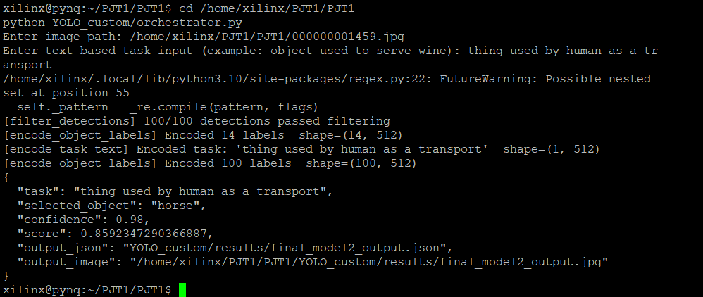
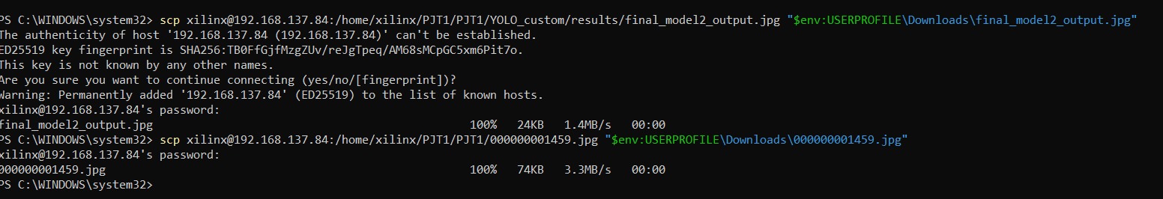
Results & Analysis (75%)
End-to-end run on the PYNQ-Z2 board
horse
Selected object
0.980
Detection confidence
0.859
Final task score
100 / 100
Detections passed filtering
Top: orchestrator.py on the board (xilinx@pynq). Bottom: JSON and annotated frame copied to the host over SCP.
Task: “thing used by human as a transport”
10
Notes:
Add your results here — graphs, tables, screenshots or outputs.

Slide 12
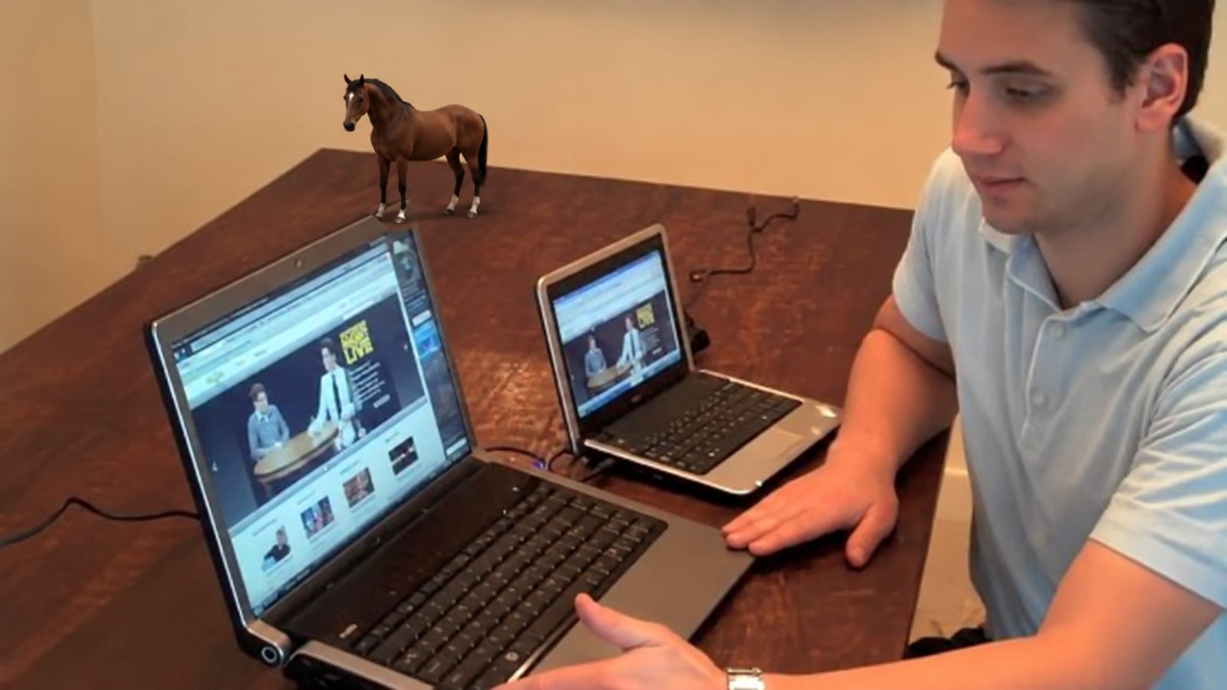
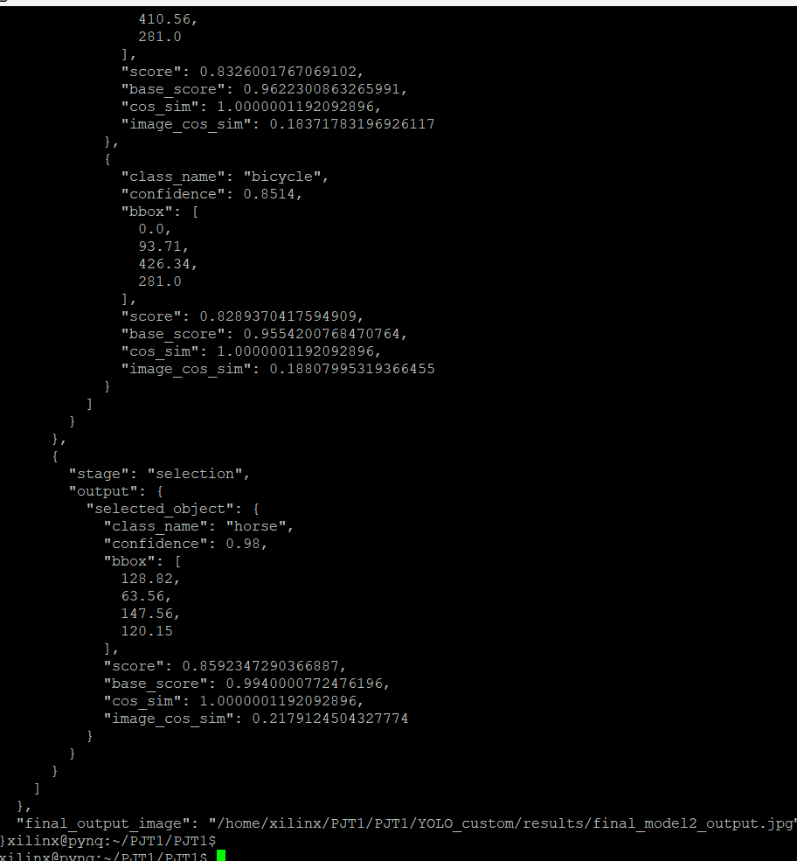
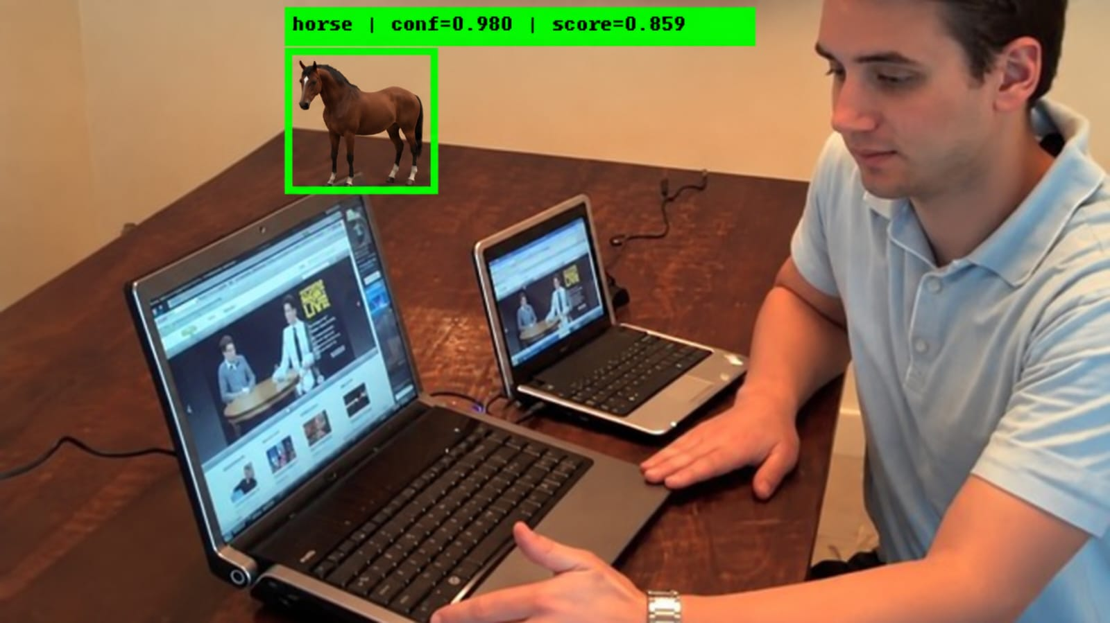
Results & Analysis (contd.): Input, Output and Ranking
Candidate | Det. conf. | Base score | Image cos-sim | Final score
horse (selected) | 0.980 | 0.994 | 0.218 | 0.859
horse | 0.907 | 0.972 | 0.223 | 0.846
bicycle | 0.851 | 0.955 | 0.188 | 0.829
Top candidates from the ranking stage of final_model2_output.json
Analysis
Both horse boxes share the same label-to-task similarity (cos_sim ≈ 1.0), so the image–text term and detection confidence decide the winner.
The selected horse leads bicycle by 0.030 in final score, a clear margin for the robot’s choice.
Scores sit in a narrow 0.83–0.86 band, so a confidence threshold is needed before acting.
Input frame (000000001459.jpg)
Output frame with selected-object overlay
11
Notes:
Add your results here — graphs, tables, screenshots or outputs.

Slide 13
Results (contd.): Assistive-Robotics Demo Scene
Input: robot’s view of a desk scene
Output: horse | conf = 0.980 | score = 0.859
Task
“thing used by human as a transport”
Selected
horse, conf 0.980
Target
bbox → centre (x, y)
Robot
navigate / point / grasp
Demo frame prepared to visualise the pipeline output for the assistive-robotics use-case.
12

Slide 14
Results (contd.): Household Task Queries
Task given to robot | Selected object | Conf. | Score
Object used to serve wine | Wine glass | 0.914 | 0.807
Beer bottle open | Bottle | 0.877 | 0.813
Item to smear butter on bread | Knife | 0.905 | 0.765
Substance which contains sugar | Cup | 0.869 | 0.774
I want to sit in a relaxed manner | Toilet | 0.875 | 0.763
Something placed on the carpet | Couch | 0.932 | 0.753
Object used to control fire | Fire hydrant | 0.879 | 0.763
Thing used by human as a transport | Horse | 0.980 | 0.859
Across all 15 test queries: mean final score 0.755, mean confidence 0.794. Debatable picks (e.g. “sit in a relaxed manner” → toilet rather than couch) show the next step: a household-specific evaluation set with top-1 accuracy.
13

Slide 15
Challenges & Remaining Work
Challenges faced and solutions
Same-class candidates tie on label similarity (cos_sim ≈ 1.0) → added image–text similarity and detection confidence to the final score.
Many raw YOLO boxes per frame → filtering + NMS stage before CLIP ranking.
Detector errors pass straight to ranking → plan a minimum-confidence gate before the robot acts.
CLIP is heavy for the Cortex-A9 → text encoder only; label embeddings to be cached / quantised.
Remaining work (25%)
Live camera input via AXI VDMA and HDMI overlay.
Benchmark FPS, latency, power and LUT / DSP / BRAM utilisation.
Household task test set (COCO-Tasks style) with top-1 accuracy.
Send selected target (bbox centre) to a robot controller demo.
Timeline to Review-III (28.10.2026)
1 – 7 Oct
Live camera + VDMA streaming
8 – 14 Oct
FPS, latency, power, resource benchmarks
15 – 21 Oct
Household task test set & accuracy
22 – 28 Oct
Robot-interface demo, report, Review-III
14

Slide 16
References (1/2)
[1] J. Redmon, S. Divvala, R. Girshick, and A. Farhadi, “You Only Look Once: Unified, Real-Time Object Detection,” in Proc. IEEE CVPR, 2016, pp. 779–788.
[2] J. Redmon and A. Farhadi, “YOLO9000: Better, Faster, Stronger,” in Proc. IEEE CVPR, 2017, pp. 7263–7271.
[3] Z. Yan, B. Zhang, and D. Wang, “An FPGA-Based YOLOv5 Accelerator for Real-Time Industrial Vision Applications,” Micromachines, vol. 15, no. 9, Art. no. 1164, 2024, doi: 10.3390/mi15091164.
[4] E. Emmanuel, F. Lacy, and Y. Ismail, “Optimizing Resource Utilization and Power Efficiency in FPGA-Accelerated YOLOv8 Object Detection Using Vivado HLS,” in Proc. 2nd Int. Conf. AIBThings, 2024, pp. 1–4, doi: 10.1109/AIBThings.2024.10863546.
[5] X. Sha, M. Yanagisawa, and Y. Shi, “An FPGA-Based YOLOv6 Accelerator for High-Throughput and Energy-Efficient Object Detection,” IEICE Trans. Fundamentals, vol. E108-A, no. 3, pp. 473–481, 2025.
[6] Z. Zhang, M. A. P. Mahmud, and A. Z. Kouzani, “Resource-Constrained FPGA Implementation of YOLOv2,” Neural Comput. Appl., vol. 34, no. 19, pp. 16989–17006, 2022.
[7] Y. Umuroglu et al., “FINN: A Framework for Fast, Scalable Binarized Neural Network Inference,” in Proc. ACM/SIGDA Int. Symp. FPGA, 2017, pp. 65–74.
[8] A. Radford et al., “Learning Transferable Visual Models From Natural Language Supervision,” in Proc. ICML, PMLR vol. 139, 2021, pp. 8748–8763.
15

Slide 17
References (2/2)
[9] J. Sawatzky, Y. Souri, C. Grund, and J. Gall, “What Object Should I Use? – Task Driven Object Detection,” in Proc. IEEE/CVF CVPR, 2019, pp. 7605–7614.
[10] P. Li et al., “TOIST: Task Oriented Instance Segmentation Transformer with Noun-Pronoun Distillation,” in Proc. NeurIPS, 2022.
[11] J. Tang, G. Zheng, J. Yu, and S. Yang, “CoTDet: Affordance Knowledge Prompting for Task Driven Object Detection,” in Proc. IEEE/CVF ICCV, 2023.
[12] M. Minderer et al., “Simple Open-Vocabulary Object Detection with Vision Transformers,” in Proc. ECCV, 2022.
[13] T. Cheng, L. Song, Y. Ge, W. Liu, X. Wang, and Y. Shan, “YOLO-World: Real-Time Open-Vocabulary Object Detection,” in Proc. IEEE/CVF CVPR, 2024.
[14] M. Shridhar, L. Manuelli, and D. Fox, “CLIPort: What and Where Pathways for Robotic Manipulation,” in Proc. CoRL, PMLR vol. 164, 2021.
[15] M. Ahn et al., “Do As I Can, Not As I Say: Grounding Language in Robotic Affordances,” in Proc. CoRL, PMLR vol. 205, 2022.
16

Slide 18
Thank You
Task-Aware Object Identification for Assistive Robotics · Shubh Gupta · Aarav Sharma · Ankush Kumar Jaiswal
Project-I (2026) · SENSE · VIT Chennai
17

